Slide 1
Reasoning, Proof, and Justification:
It’s not just for geometry anymore
Denisse R. Thompson
University of South Florida, USA
2011 Annual Mathematics Teachers Conference
Singapore
June 2, 2011

Slide 2
Reasoning is a critical process
“Reasoning mathematically is a habit of mind, and like all habits, it must be developed through consistent use in many contexts.”
(Principles and Standards for School Mathematics, p. 56)

Slide 3
Reasoning is a critical process
Recognize reasoning & proof as fundamental aspects of mathematics
Make and investigate conjectures;
Develop and evaluate mathematical arguments and proofs;
Select and use various types of reasoning and methods of proof.
(Principles and Standards for School Mathematics, p. 56)

Slide 4
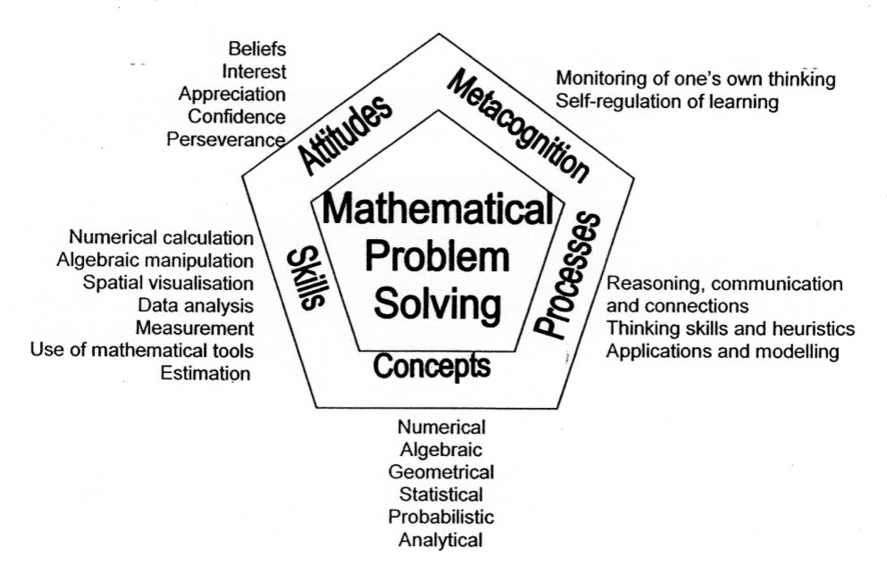
Reasoning is a critical process
Singapore curriculum framework

Slide 5
Importance of Proof in the Curriculum
“… the possibility of proof is what makes mathematics what it is, what distinguishes it from other varieties of human thought” (Hersh, 2009, p. 17)
“Students cannot be said to have learned mathematics, or even about mathematics, unless they have learned what a proof is” (Hanna, 2000, p. 24)

Slide 6
General Difficulties with Proof
Meaning or purpose of a proof
Use of empirical examples as a proof
Lack of knowledge of needed concepts
Definitions and notation
Unfamiliarity with proof strategies
Knowing how to get started
Monitoring one’s progress while attempting a proof

Slide 7
Two Guiding Questions
How can we ensure that students have many opportunities to engage with reasoning, proof, and justification throughout their secondary curriculum?
How can those opportunities provide teachers with insight into their students’ thinking that can help modify and enhance instruction?

Slide 8
The Curriculum is Key
The textbook is a “variable that on the one hand we can manipulate and on the other hand does affect student learning.”
(Begle, 1973, p. 209)
Look for opportunities within the textbook, and when not present, consider how we might modify items or tasks to engage students in reasoning and explaining their thinking.

Slide 9
Six Aspects to Proof-related Reasoning
  finding counterexamples
making conjectures
investigating conjectures
developing arguments
evaluating arguments
correcting mistakes in logical arguments
(Johnson, Thompson, & Senk, 2010)

Slide 10
Finding a Counterexample
The use of examples and non-examples is an important prerequisite to making and evaluating conjectures.
One or several examples cannot prove a generalization true. But one counterexample can disprove a statement.
Epp (1998) argues that finding counterexamples is easier than writing a proof – good first step.

Slide 11
Finding a Counterexample
Give an example to show that m – n = n – m is not necessarily true.
Find a counterexample to show that a² > a is not always true.
Give a counterexample to show that
(x + y)² = x² + y² is false.
(Prentice Hall Algebra I, 2004)
Notice that the directions tell students how to start.

Slide 12
Make a Conjecture
As students make a generalization, they may come to realize that a proof requires showing the statement is true in all cases.
Notice that r²/r² = 1, where r is not 0. Does this suggest a definition of a zero exponent? Explain.
(Holt Algebra I, 2004)

Slide 13
Make a Conjecture
The quadratic formula provides
solutions to ax² + bx + c = 0. Make up
some rules involving a, b, and c that
determine the solutions are non-real.
(Key Advanced Algebra, 2004)

Slide 14
Make a Conjecture
Consider the equation y = 3^{x}. Write a conjecture about the relationship between the value of the base and the value of the power if the exponent is greater than or less than 1.
(Glencoe Advanced Math: Precalculus, 2004)

Slide 15
Investigate a Conjecture
Students do not necessarily know if the conjecture is true or false, so they have to bring other reasoning skills to bear.
  This is more aligned with the way that mathematicians work.
Determine whether the pair of monomials (5m)² and 5m² is equivalent. Explain.
(Glencoe Algebra I, 2004)
  There might be several ways that students could explore this conjecture – try some numbers, graph the two expressions, use an algebraic proof.
  Students with different learning styles have different ways to engage with the problem.

Slide 16
Investigate a Conjecture
If you use a calculator to graph y = x² and
y = x⁴ it may look as if x² ≤ x⁴ for all values of x. Use the zoom feature on a graphing calculator and inspection of tables for each relation to test that conjecture.
(Core Plus Course 3, 1999)

Slide 17
Develop an Argument
Deductive arguments might occur for specific cases as a precursor for more general cases, what we typically consider as a proof.
Explain how you could verify that the Product-of-Powers Property is true for 2³ * 2⁴.
(Holt Algebra I, 2004)
Write a convincing argument to show why
3⁰ = 1 using the following pattern.
3⁵ = 243, 3⁴ = 81, 3³ = 27, 3² = 9, …
(Glencoe Algebra I, 2004)

Slide 18
Develop an Argument
The following statements support the reasoning behind the definition of a⁰ for all positive values of a. For each step shown, supply a general property of number operations to support that step.
1=a^{x-x}
= a⁰
So, 1 = a⁰
(Core Plus Course 2, 1998)

Slide 19
Develop an Argument
On one chemistry test, Amelia scored 97 when the class mean was 85 with a standard deviation of 4.8. On a second chemistry test, Amelia scored 82 when the class mean was 75 with a standard deviation of 2.7. On which test did Amelia score better in relation to the rest of the class? Explain your reasoning.

Slide 20
Evaluate an Argument
Evaluating an argument is at a different level than writing one’s own argument. A teacher or peer may have used a different approach, and students need to be able to determine if these arguments are valid or not.

Slide 21
Evaluate an Argument
An algebra class has this problem on a quiz:
Find the value of 2x² when x = 3. Two students reasoned differently.
Student 1: Two times three is six. Six squares is thirty-six.
Student 2: Three squared is nine. Two times nine is eighteen.
Who was correct and why?
(Key Discovering Algebra, 2007)

Slide 22
Correct a Mistake
Students are told there is a mistake and they have to find it. This type of task is similar to evaluating an argument, except that students know there is an error.

Slide 23
Correct a Mistake
Find the error. Nathan and Poloma are simplifying (5²)(5⁹).
Nathan Poloma
(5²)(5⁹) = (5 * 5)²⁺⁹ (5²)(5⁹) = 5²⁺⁹
=25¹¹ =5¹¹
Who is correct? Explain your reasoning.
(Glencoe Algebra I, 2004)
Find the error. x² + 2x = 15
x(x + 2) = 15
x = 15 or x + 2 = 15
x = 15 or x = 13
(Glencoe Algebra II, 2004)

Slide 24
Correct a Mistake
The following statements appear to prove that 2 is equal to 1. Find the flaw in this "proof."
Suppose a and b are real numbers such that
a = b, a ≠ 0, b ≠ 0.
a = b
a² = ab
a² - b² = ab - b²
(a – b)(a + b) = b(a – b)
a + b = b
a + a = a
2a = 1
2 = 1
(Glencoe Algebra I, 2004)

Slide 25
General Ideas for Modifying Items
Use vocabulary to signal that proof-related reasoning is needed
  Explain
  Explain why
  Why
  Show
  Show that
  Prove

Slide 26
General Ideas for Modifying Items
Highlight concepts that you know are potential difficulties for students
  Through finding counterexamples
  Through investigating conjectures
  Through identifying common errors
  Through creating an argument and having students evaluate it
Use examples of student work (anonymously) to generate tasks, particularly for evaluating arguments or correcting mistakes

Slide 27
General Ideas for Modifying Items
Consider using language that does not give away the answer
  Prove or disprove
  True or false
  Is the student correct? Why or why not?
Replace 1 or 2 problems in each homework assignment with tasks in which students are expected to engage in reasoning
  Students need to be convinced that such tasks are not going away

Slide 28
Example 1: Decimals
Name a decimal that estimates the value of point A.
Why did you give A that value?

Slide 29
Sample Responses
(Chappell & Thompson, 1999)

Slide 30
Example 2: Decimals
Do .3 and .30 name the same amount?
Explain your answer.

Slide 31
Sample Responses
Response 1
  No, because .3 is three and .30 means thirty so they can’t be the same amount
Response 2
  Yes, zeros put on a decimal like 0.3 or .30 don’t matter. Zeros put on a decimal like .03 do matter
Response 3
  Yes, .3 = .30 because saying .3 instead of .30 is just reducing it.
The first one is reduced

Slide 32
Example 3: Percents
Typical problem:
  An item normally costs $250 but is on sale for 20% off. What is the sale price, before tax?
Possible revision to encourage reasoning:
  When an item is on sale at 20% off, you can always find the costs of the item (before tax) by multiplying its original price (non-sale) price by .80.
      True False
    If you marked True, explain why this works. If you marked False, explain why the statement is false.
      (Thompson et al., 2005)

Slide 33
Sample Approaches
Pick a specific price and show that both ways work.
Pick an arbitrary price, x, and use the distributive property to show that
x – 0.2x = (1 - 0.2)x = 0.8x
Responses to such tasks help us learn whether students have a conceptual understanding of the mathematical principles or whether they are just following a set of procedures rotely.

Slide 34
Example 4: Expanding Binomials
For all numbers x and y, is it true that
x² + y² = (x + y)²?
  Yes No
Imagine that someone does not know the answer to the question. Explain how you would convince that person that your answer is correct.

Slide 35
Sample Responses
Student Response 1
  Well, just take, for example, x = 8 and y = 6
  So 8² + 6² = 100 and (8 + 6)² = 196. So it’s wrong to say “all numbers”
Student Response 2
  Show any two in here
  5² + 6² = (5 + 6)²
  25 + 36 = (25 + 36)²
  61 ≠ 61²
  4² + 8² = ( 4 + 8)²
  16 + 64 ≠ 12² = 24

Slide 36
Example 5: Expanding Binomials
Is (x + 4)² = x² + 16? Explain why or why not.
Sample Responses with graphing calculators
  No, (x + 4)² = 49 and x² + 4 = 13
  Yes, (x + 4)² = 16 and x² + 4 = 16
What caused the difference?
  Students failed to realize that the calculator evaluated the expression for the value that is stored in x.
Another variation: Is (x + 4)² = x² + 16 always true, sometimes true, or never true? Explain.

Slide 37
Example 6: Quadratics
Typical problem:
  Write y = 4x² + 24x + 31 in vertex form.
Possible revision:
  On a test, one student found an equation for a parabola to be y – 5 = 4(x + 3)². For the same parabola, a second student found the equation
  y = 4x² + 24x + 31. Can both students be right? Explain your answer.
Approaches:
  Graph both equations
  Expand the first one
  Rewrite the second into vertex form
  Substitute a value for x into both equations – if two different y-values result the two equations are not equal
  It is possible that neither is correct.

Slide 38
Your Turn at Modifying Items
With someone near you, take one of the following problems and write 2 modifications to engage in proof-related reasoning.
Grade 7: Solve 4x – 7x < -24
Grade 8: Find the mean and median of a set of data.
Grade 9: The product of two consecutive integers is 552. Find the integers.
Grade 10: Given that vector a = (6, 8) and vector b = (r, 0), where r is positive, find the value of r such that |a| = |b|.

Slide 39
Grade 7
Original item:
  Solve 4x – 7x < -24
Possible revisions:
  Correct the mistake in the following solution:
    4x – 7x < - 24
    – 3x < -24
    x < 8
    Find a counterexample to show that x < 8 is not the solution to 4x – 7x < -24.

Slide 40
Grade 8
Original item:
  Find the mean and median of a set of data.
Possible revisions:
  True or false. Explain. In any data set, the mean is always greater than the median.
  Show that when 5 is added to every value in a data set, the mean and median both increase by 5.
  Find a set of 10 values so that the mean is 25 and the median is 18.

Slide 41
Grade 9
Original item:
  The product of two consecutive integers is 552. Find the integers.
Possible revisions:
  To find two consecutive integers whose product is 552, Balpreet first took the square root of 552. She got 23.49468025. So, she decided the numbers were 23 and 24. Will her method always work? Justify your solution.
  Jericho found the product of 12 and 46 to be 552. Do his numbers satisfy the problem? Why or why not?

Slide 42
Grade 10
Original item:
  Given that vector a = (6, 8) and vector b = (r, 0), where r is positive, find the value of r such that
  |a| = |b|.
Possible revisions:
  Under what conditions would the two vectors a = (6, 8) and b = (r, 0) have congruent magnitudes? Explain.
  Marshall wanted to find the value of r so that vector
  b = (r, 0) and vector a = (6, 8) have equal magnitudes. He submitted the following work:
      Sqrt (r + 0) = sqrt (6² + 8²), so r = 100.
    Evaluate his reasoning and correct any errors.

Slide 43
Thank you!
denisse@usf.edu

Slide 44
References
Begle, E. (1973). Lessons learned from SMSG. Mathematics Teacher, 66, 207-214.
Bellman, A. E., Bragg, S. C., Charles, R. I., Handlin, Sr., W. G., & Kennedy, D. (2004). Algebra 1 Florida Teacher’s Edition. Needham, MA: Pearson Prentice Hall.
Chappell, M. F., & Thompson, D. R. (1999). Modifying our questions to assess students’ thinking. Mathematics Teaching in the Middle School, 4, 470-474.
Coxford, A. E., Fey, J. T., Hirsch, C. R., Schoen, H. L., Burrill, G., Hart, E. W., Watkins, A. E., Messenger, M. J., & Ritsema, B. E. (1998b). Contemporary mathematics in context: A unified approach Course 2. Chicago, IL: Everyday Learning.
Coxford, A. E., Fey, J. T., Hirsch, C. R., Schoen, H. L., Burrill, G., Hart, E. W., Watkins, A. E., Messenger, M. J., & Ritsema, B. E. (1999). Contemporary mathematics in context: A unified approach Course 3. Chicago, IL: Everyday Learning.
Epp, S. S. (1998). A unified framework for proof and disproof. Mathematics Teacher, 91, 708-713.
Hanna, G. (2000). Proof, explanation, and exploration: An overview. Educational Studies in Mathematics, 44, 5-23.
Hersh, R. (2009). What I would like my students to already know about proof. In D. A. Stylianou, M. L. Blanton, & E. J. Knuth (Eds.), Teaching and learning proof across the grades: A K – 16 perspective (pp.17-20). New York: Routledge.
Holliday, B., Cuevas, G. J., McClure, M. S., Carter, J. A., & Marks, D. (2004). Advanced mathematical concepts: Precalculus with applications. Columbus, OH: Glencoe/McGraw-Hill.

Slide 45
References
Holliday, B., Cuevas, G. J., Moore-Harris, B., Carter, J. A., Marks, D., Casey, R. M., Day, R., & Hayek, L. M. (2004). Algebra 1. Columbus, OH: Glencoe/McGraw-Hill.
Holliday, B., Cuevas, G. J., Moore-Harris, B., Carter, J. A., Marks, D., Casey, R. M., Day, R., & Hayek, L. M. (2003). Algebra 2. Columbus, OH: Glencoe/McGraw-Hill.
Johnson, G., Thompson, D. R., & Senk, S. L. (2010). Proof-related reasoning in high school textbooks. Mathematics Teacher, 103, 410-417.
Murdock, J., Kamischke, E., & Kamischke, E. (2007). Discovering algebra: an investigative approach (Second Edition). Emeryville, CA: Key Curriculum Press.
Murdock, J., Kamischke, E., & Kamischke, E. (2004). Discovering advanced algebra: an investigative approach. Emeryville, CA: Key Curriculum Press.
National Council of Teachers of Mathematics. (2000). Principles and standards for school mathematics. Reston, VA: Author.
Schultz, J. E., Kennedy, P. A., Ellis, Jr., W., & Hollowell, K. A. (2004). Algebra 1. Austin, TX: Holt, Rinehart and Winston.
Thompson, D. R., Senk, S. L., Witonksy, D., Usiskin, Z., & Kealey, G. (2005). An evaluation of the second edition of UCSMP Transition Mathematics. Chicago, IL: University of Chicago School Mathematics Project.

