Slide 1
What Senior Mathematics Could we Aim to Teach in School and How Might we Approach It?
Mike Thomas
Auckland University

Slide 2
Overview
The University of Auckland
Current focus in senior mathematics around the world
Some difficulties with this
Potential expansion of focus for senior mathematics
Some benefits of this approach

Slide 3
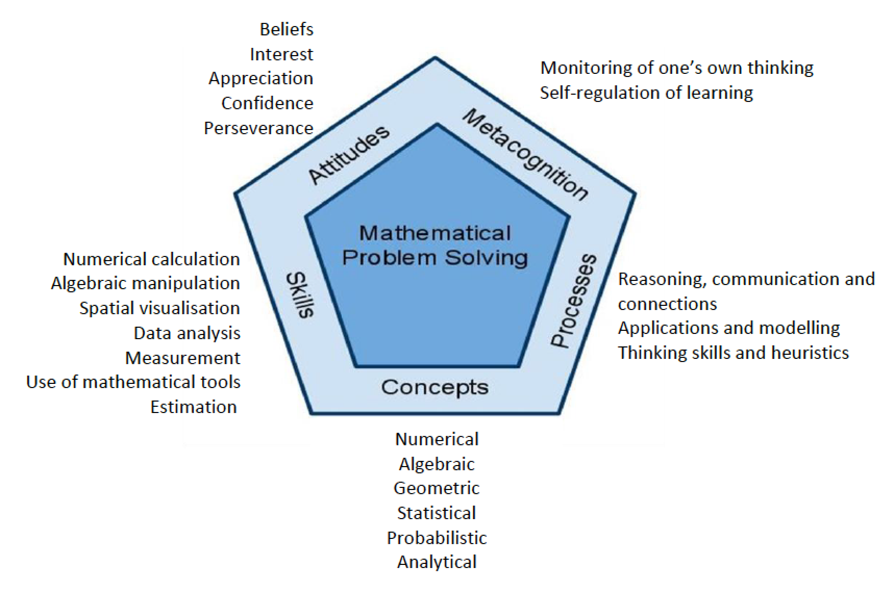
The Curriculum Framework
The University of Auckland

Slide 4
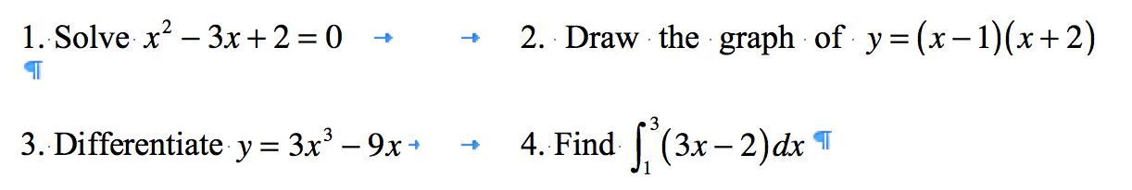
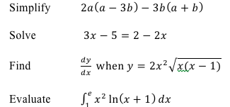
A Common Examination Focus
The University of Auckland

Slide 5
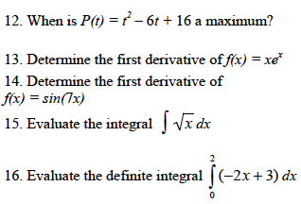
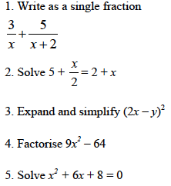

The Extent of the Problem
The University of Auckland
What percentage of 1000 students in the final year of Australian school do you think correctly answered these questions?
Notes:
1000+ students in first week of university

Slide 6
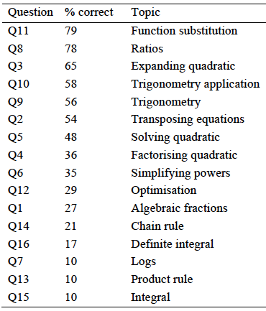
Here are the question facilities: All are ≤ 35%
The University of Auckland
Jennings (2011). The Transition From High School to University: The University of Queensland Perspective. In J. Hannah & M. O. J. Thomas (Eds.) Proceedings of Delta 2011, The Eighth Southern hemisphere Conference on Teaching and Learning Undergraduate Mathematics and Statistics (pp. 139-149), Rotorua: Delta.
Notes:
University of Queensland (UQ) is Queensland’s oldest university and is a member of the G08 and Universitas21. Traditionally it has attracted the brightest students in Queensland and northern New South Wales.

Slide 7
A Conclusion
The University of Auckland
Under-prepared university students
  The characteristics of students in Australian undergraduate university mathematics courses have changed markedly in recent years. Students are now entering university with weaker mathematical backgrounds and changes have had to be made to mathematics and engineering programmes to accommodate these students…Students remember and understand little of their senior secondary mathematics in comparison to their junior secondary content, and this has serious implications for university staff.
Jennings, M. (2011). The Transition From High School to University: The University
of Queensland Perspective. In J. Hannah & M. O. J. Thomas (Eds.) Proceedings of Volcanic Delta 2011 The Eighth Southern hemisphere Conference on Teaching and Learning Undergraduate Mathematics and Statistics (pp. 139-149), Rotorua: Delta.

Slide 8
The view of university lecturers
The University of Auckland
How would you rate first year students’ mathematical understanding of each of the following on entry to university? (Max score = 5)
Algebra 3.0 Functions 2.8
Real numbers 2.7 Differentiation 2.5
Complex numbers 1.9 Sequences and series 1.9
Definitions 1.9 Vectors 1.9
Riemann integration1.8 Limits 1.7
Matrix algebra 1.7 Proof 1.6
  Thomas, M. O. J., De Freitas Druck, I., Huillet, D., Ju, M-K., Nardi, E., Rasmussen, C., & Xie, J. (2015). Key mathematical concepts in the transition from secondary school to university. Proceedings of The 12th International Congress On Mathematical Education (ICME-12) Survey Team 4 (pp. 265-284). Seoul, Korea.

Slide 9
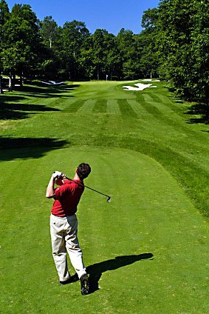
How can we Address This? Aim wider – Not this one
The University of Auckland

Slide 10
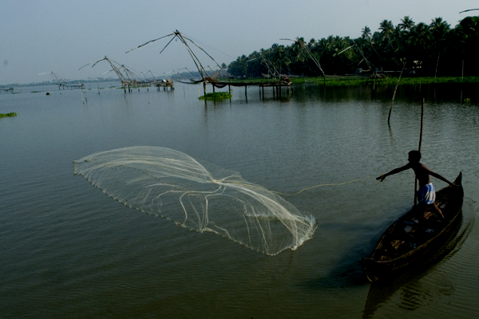
Aim wider – More this one
The University of Auckland

Slide 11
What might we aim for?
The University of Auckland
Education … has produced a vast population able to read but unable to distinguish what is worth reading.
G. M. Trevelyan (1876-1962) British historian
Any fool can know. The point is to understand.
Albert Einstein
Actually, most mathematics courses do not teach reasoning of any kind. Students are so baffled by the material that they are obliged to memorize in order to pass examinations.
Morris Kline, mathematician
Notes:
Discern, understand and reason

Slide 12
So what might we aim for?
The University of Auckland
Discernment, discrimination
Conceptual understanding as well as algebraic manipulation
Understanding rather than just knowing
Ability to reason not just memorise
Let’s call this part of aiming wider…

Slide 13
What We Know: Mathematics Takes Effort
The University of Auckland
Mathematics is amazingly compressible: you may struggle a long time, step by step, to work through some process or idea from several approaches. But once you really understand it and have the mental perspective to see it as a whole, there is often a tremendous mental compression. You can file it away, recall it quickly and completely when you need it, and use it as just one step in some other mental process.
(Thurston, 1990, p. 846)
We know that this takes real effort

Slide 14

What is learning mathematics like for some students?
The University of Auckland
The depth of mathematics makes learning it like building something when we don’t know what it should look like
We can think of it as like building a flat pack without knowing what it should look like

Slide 15
Mathematics as construction
The University of Auckland
It can be very frustrating
Companies are set up to build the furniture for adults

Slide 16
The instructions may not make sense
The University of Auckland
eg Locate the asymmetric shelf, 6 cams, 6 small cam screws and 4 medium dowels. Insert 6 cams into each shelf. Make sure arrows on each cam point toward the nearest edge with holes. Insert 8 cam screws into top panel. Secure, but do not over tighten screws, using a phillips head screwdriver. Insert 4 wood dowels and 2 cams into each large shelf…
Notes:
Have you ever met instructions like these?

Slide 17
What We Know:
The University of Auckland
As teachers we know:
  what maths should look like in the end
  what the parts of maths look like
  how to distinguish similar parts
  how the parts of maths fit together, and
  the order they should be put together so that the knowledge will stay together and not fall apart
So we have a responsibility to guide students in our teaching

Slide 18
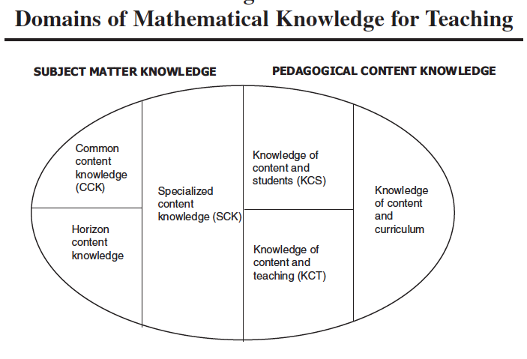
This requires Mathematical Knowledge for Teaching (MKT)
The University of Auckland
(Ball, Thames & Phelps, 2008)

Slide 19
Horizon Content Knowledge
The University of Auckland
Horizon content knowledge is an awareness of how mathematical topics are related over the span of mathematics included in the curriculum.
It also includes the vision useful in seeing connections to much later mathematical ideas.
First grade teachers, for example, may need to know how the mathematics they teach is related to the mathematics students will learn in third grade to be able to set the mathematical foundation for what will come later.
So in the last year of school we need to think about what students will meet in university.
(Ball, Thames & Phelps, 2008)

Slide 20
How can we help students?
The University of Auckland
A key factor seems to be to pay more attention to what students are thinking
This has been described as productive noticing (Choy, 2015)
It involves planning to anticipate student thinking, listening to students’ reasoning and building on their mathematical thinking
Notes:
Discern, understand and reason

Slide 21
Structure of Attention: John Mason
The University of Auckland
A key notion in the learning process is to match what the students and the teacher are attending to
At any point in a lesson either may be:
  attending holistically,
  discerning details,
  recognising relationships,
  perceiving properties,
  ready to reason on the basis of properties alone
One way to focus attention and assist with noticing is to ask students appropriate questions

Slide 22
What are students thinking? Equations
The University of Auckland
Pick out those statements that are equations from the following list and write down why you think the statement is an equation:
  a) k = 5
  b) 7w – w
  c) 5t – t = 4t
  d) 5r – 1 = –11
  e) 3w = 7w – 4w
Godfrey, D., & Thomas, M. O. J. (2008). Student perspectives on equation: The transition from school to university. Mathematics Education Research Journal, 20(2), 71-92.

Slide 23
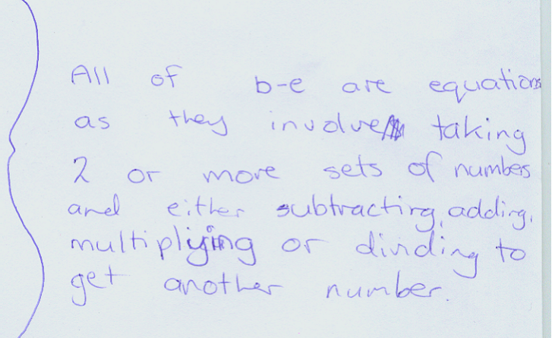
What are students thinking? Equations
The University of Auckland
Equations need an operation
Godfrey, D., & Thomas, M. O. J. (2008). Student perspectives on equation: The transition from school to university. Mathematics Education Research Journal, 20(2), 71-92.
Notes:
This was a year 10 student; age 15 years

Slide 24
What are students thinking? Equations
The University of Auckland
Godfrey, D., & Thomas, M. O. J. (2008). Student perspectives on equation: The transition from school to university. Mathematics Education Research Journal, 20(2), 71-92.

Slide 25
Student thinking: Concepts
Which two are equivalent?
Can you find another equivalent expression?
A student wrote…
…but he factorised C!

Slide 26
Student Thinking: A subtle problem
The University of Auckland
  Consider
  a(b – 1)
  m(x – 1)
  f (t – 1)
  The letters we use may cause students to interpret it differently making a difference to the meaning we give to the representations.

Slide 27
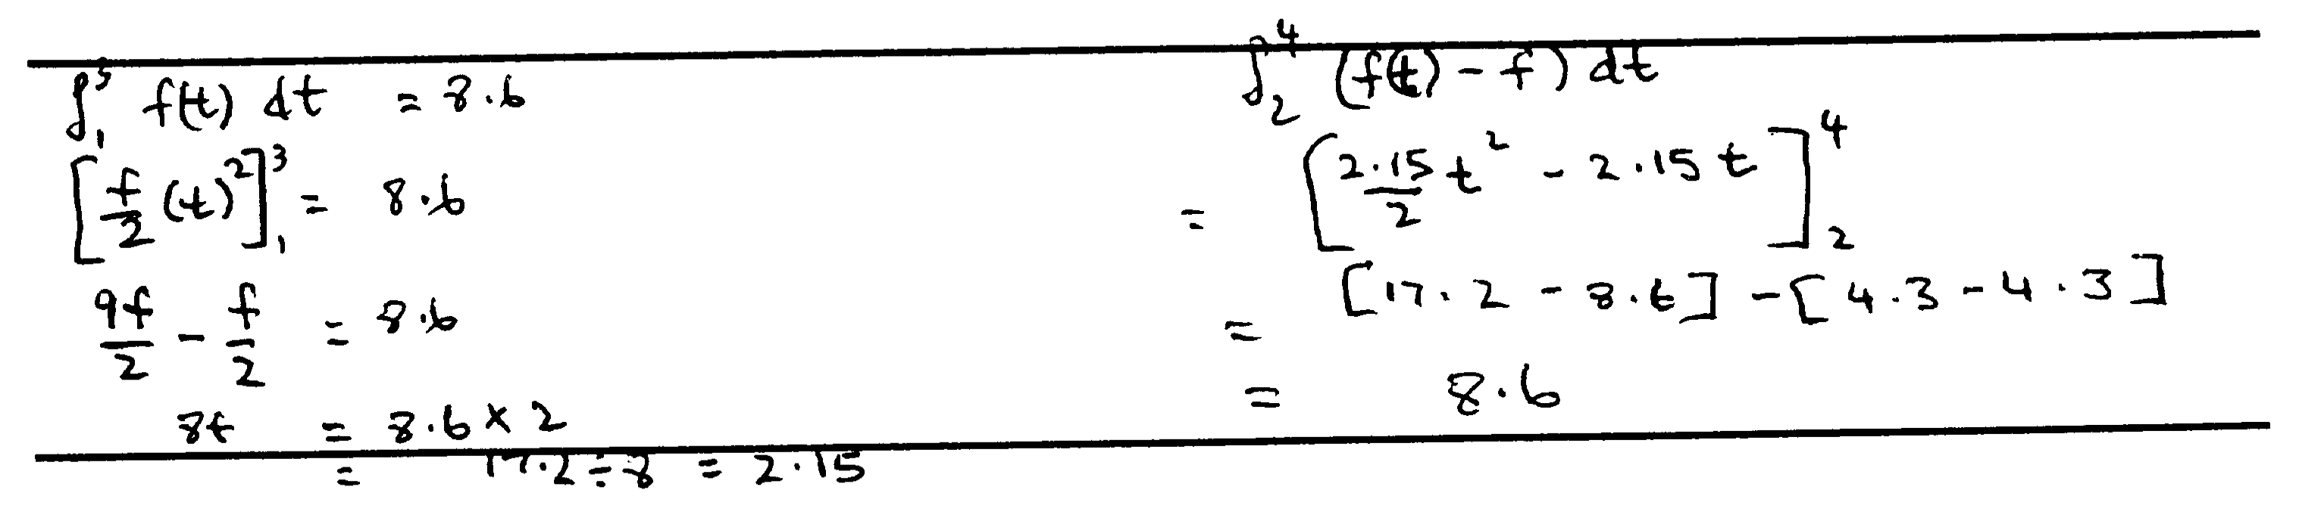
Student Thinking: An example of Confusion
The University of Auckland

Slide 28
Student Thinking: Procedure versus concept
The University of Auckland
Let
For what values of x is f(x) increasing?
Some could answer this using algebra but…

Slide 29
Student Thinking: Procedure versus concept
The University of Auckland
For what values of x is this function increasing?

Slide 30
One aim—Versatile Thinking
The University of Auckland
Representational versatility—the ability to work seamlessly within and between representations, and to engage in versatile interactions with representations
Exploiting the power of visual schemas by linking them to the analytic
Perceiving mathematical entities in a given representation system as a process or an object as required

Slide 31
The Blocks Problem
The University of Auckland

Slide 32
The Blocks Problem: Solution Method
The University of Auckland
1
 | 2
 |  | 1
 |  |  | 2
6≤N≤20

Slide 33
A Possible Task: Representational Versatility
The University of Auckland
Ruhama Even gives another nice example:
If you substitute 1 for x in ax² + bx + c, where a, b, and c are real numbers, you get a positive number.
Substituting 6 gives a negative number.
How many real solutions does the equation
ax² + bx + c = 0 have? Explain.
Students may write:
a + b + c > 0 and 36a + 6b + c < 0
and use these to attempt a solution

Slide 34
Graphical Reasoning
The University of Auckland
1
6

Slide 35
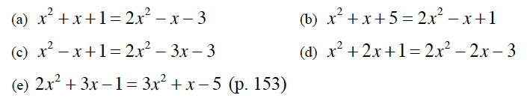
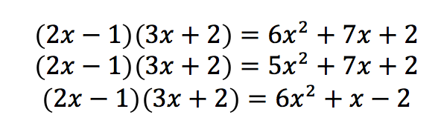
Another Possible Kind of Task
The University of Auckland
Without solving them, state which of the following equations have the same solutions. Explain your answers.
One of the following equations is true for 1 value of x, one is true for 2 values of x and one is true for all values of x. Identify the one that is true for all values of x and solve the other two.

Slide 36
Examples of a change of focus at university
The University of Auckland
There is a move from equality to a dominant role for inequality, with arbitrary closeness the important idea, producing a discontinuity (Artigue, 2010)
Pointwise, local and global perspectives are needed (Vandebrouck, 2010, 2011). Local is often lacking.
Understanding of function is central. Students don’t conceptualise function in terms of multiple representations and process-object duality
Proof becomes more important.
Let’s consider aspects of some of these…

Slide 37
Interval Thinking
The University of Auckland
Mathematics students need the ability to move between point-wise, local and global perspectives of function (Artigue, 2009)
“…working at university level on functions implies that students can adopt a local perspective on functions whereas only point-wise and global perspectives are constructed at the secondary school.” (Vandebrouck, 2011, p. 2095).
Mathematical Principle: Need to develop an interval or local view of function.

Slide 38
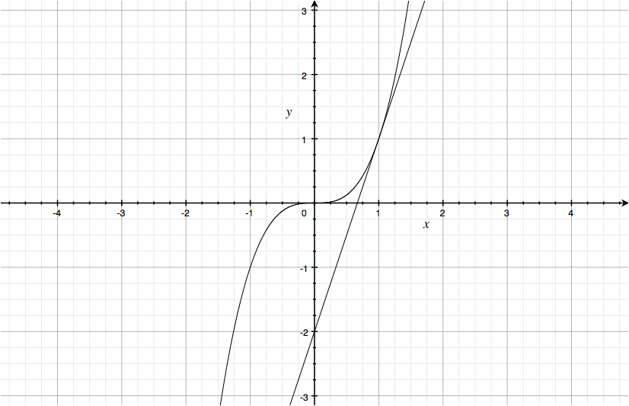
Pointwise Thinking
The University of Auckland
Find the rate of change of the function f, where
f(x) = x³, at the point (2, 8).

Slide 39
Global Thinking about Functions
The University of Auckland
Global thinking involves considering the function across the whole of its domain.
The algebraic approach to global thinking will often involve statements such as ‘∀x∈D_{f}’, where D_{f} is the domain of the function f.
Examples include whether a function is even or odd (so for odd functions f(a)=–f(a), ∀a∈D_{f}), a periodic function (where, for some k, f(a+k)=f(a), ∀a∈D_{f}) and transformations of functions (a translation, for example, where g(a)=f(a–h)+k, ∀a∈D_{f}).
Notes:
Arrow – this may also include some pointwise considerations

Slide 40
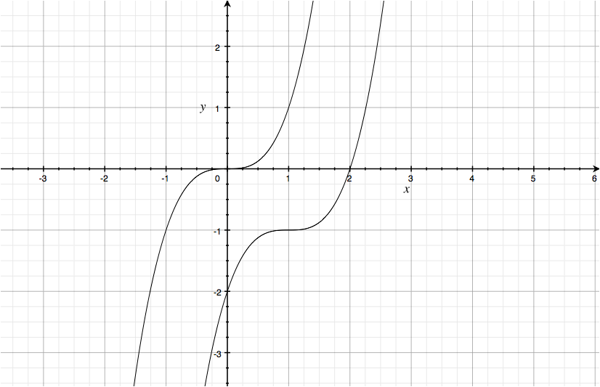
Global Thinking
The University of Auckland
If the function f is such that
f(x) = x³, sketch the graph of
y = f(x – 1) – 1.
Translate by (1, –1)
Notes:
Arrow – this may also include some pointwise considerations

Slide 41
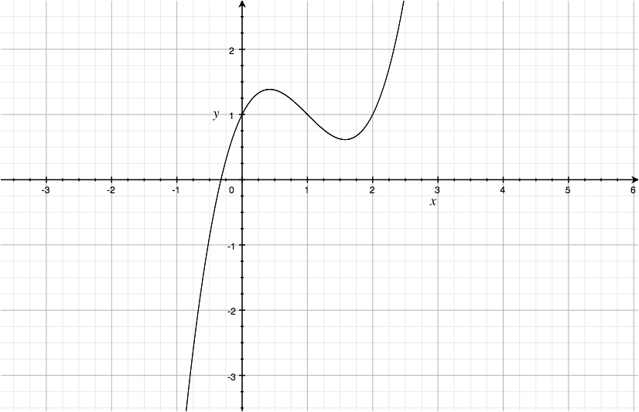
Interval Thinking
The University of Auckland
The function f is such that
f(x) = x³–3x²+2x+1.
Find the interval (a, b) for which:
(i) f’(x) < 0 and
(ii) f’’(x) < 0.
ie decreasing and concave down
Examples: concave up and down, increasing, decreasing

Slide 42
Local Thinking
The University of Auckland
A local property of a function is one that depends on the values of f in a small neighbourhood of a specific point x₀, say (x₀–δ, x₀+δ) with δ—> 0
For example, limits and continuity

Slide 43
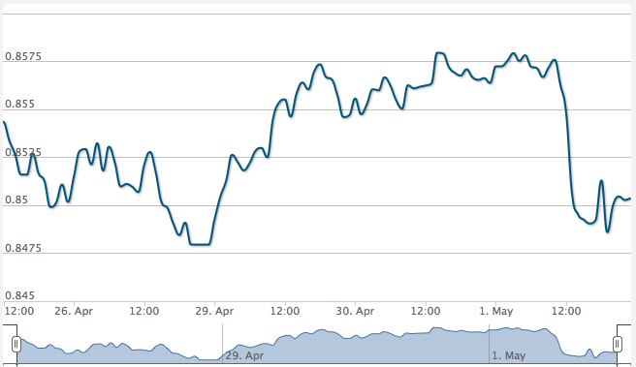
Interval Thinking: Average Rate of Change
The University of Auckland
The figure above shows the movement of the exchange rate between the NZ$ and the US$. Which 2-day period had the greatest average rate of increase of the exchange rate?

Slide 44
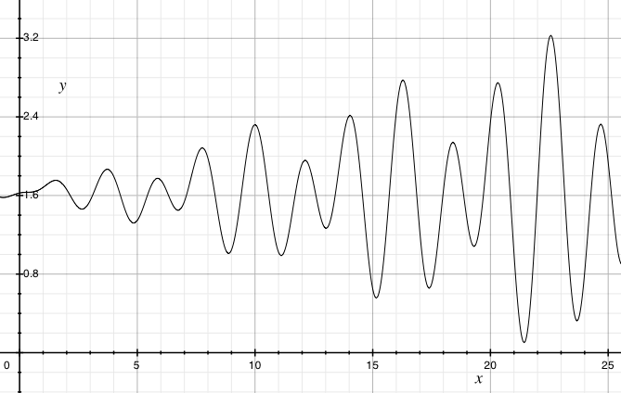
Interval Thinking: A Possible Task
The University of Auckland

Slide 45
Interval Thinking: The task
The University of Auckland
Investigate the greatest average rate of increase over an x interval of 2 for this graph. Where does it occur?
One method suggested: “Take the point at which the rate of change is greatest and take an x interval of 1 either side of it.”
How would your students tackle this?
What about an x interval of 1, or less?
If the x interval is h, what happens to the average rate of increase as h gets smaller and smaller, i.e. as h→0?

Slide 46
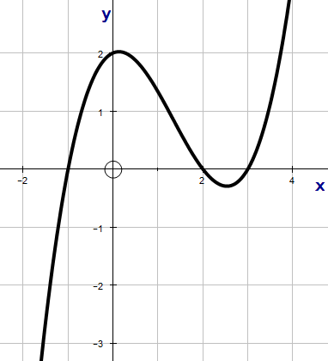
Versatility: Thinking without Algebra
The University of Auckland
How would your students answer this with no algebraic function given?
Sketch the derivative of the given graph

Slide 47
Compare an interval with a pointwise method
The University of Auckland
Repeated embodied actions versus process

Slide 48
What Students May Be Thinking
The University of Auckland
For example, here they often used a polynomial function
y=a(x+1)(x–2)(x–3)
They then used the point
(0, 2) to find a = 1/3
The brackets were then expanded
The function was differentiated symbolically
They completed the square to find the vertex
The graph of the derivative was drawn

Slide 49
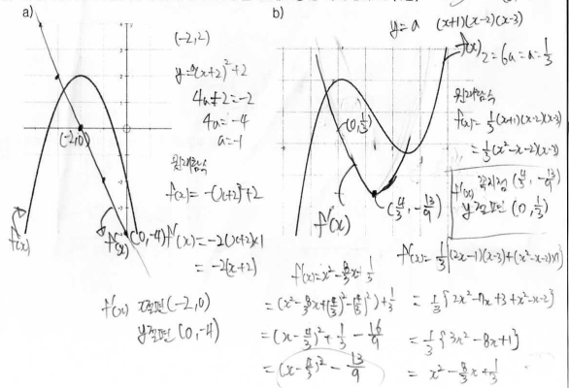
What Students May Be Thinking
The University of Auckland
Notes:
They get f'(x)=(x-4/3)^2-13/9,

Slide 50
Maximum and minimum values
The University of Auckland
When must a function f have a maximum and minimum?
Students examine the critical points. [Pointwise thinking]
Clearly not for functions in general:
f : R → R where f(x) = x or any increasing function
What about f : (a, b) → R? We are still not guaranteed a maximum and minimum value. Why? How would they understand this? [Needs local thinking]
For a continuous function f : [a, b] → R we are guaranteed a maximum and minimum
Notes:
MUST!!

Slide 51
What is a Function?
The University of Auckland
The function is one of the most important ideas in the whole of mathematics.
How do we introduce it and when?
The changing definition:
  A function of a variable quantity is an analytic expression composed in any way whatsoever of the variable quantity and numbers or constant quantities
  Euler, 1748, Introduction to the Analysis of the Infinite, I, p. 3

Slide 52
What do we say?
The University of Auckland
A function is a relation between two sets such that each and every member of the first set is related to one and only one member of the second set
At school the sets will often be subsets of the real numbers

Slide 53
Student Thinking: Functions
The University of Auckland
I got the idea that functions was a graph…I think it was in fifth or sixth form that they defined what function was and um.. they had this the vertical line test where they said OK, given for example y equals for example, x cubed… if you were to draw that on a graph by using the vertical line test and if it cuts the particular graph at one point on the x axis.. if I've got this right, and then that is what you call a function.
The algebra is the actual expression or working with the actual expression. And the function to me is the visualisation of that graph.
Chinnappan, M., & Thomas, M. O. J. (2003). Teachers’ function schemas and their role in modelling. Mathematics Education Research Journal, 15(2), 151–170.

Slide 54
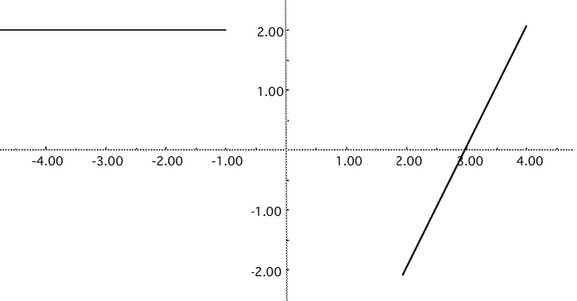
What might students be thinking?
The University of Auckland
How can we recognise something that is representing a function?
For example:
  (x, 2x), where x is a real number (8)
  (a, b) –> a + b (11)
  {(x, y) | x N, y =1} (10)
                (3)
Notes:
( ) numbers give number out of 34 trainee teachers who thought it was NOT a function

Slide 55
Thinking about Functions
The University of Auckland
Linking with graphical representations
This student learned the vertical line test for a graphical representation of a function, but mis-remembered it as a horizontal line test.
Thomas, M. O. J. (2003). The role of representation in teacher understanding of function. In N. A. Pateman, B. J. Dougherty, & J. Zilliox (Eds.), Proceedings of the 27th Conference of the International Group for the Psychology of Mathematics Education (Vol. 4, pp. 291–298). Honolulu, Hawai’i: University of Hawai’i.

Slide 56
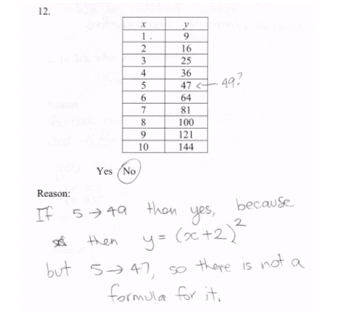
The University of Auckland
Student Thinking: Functions

Slide 57
Student Thinking: Polynomials
The University of Auckland
What is a polynomial?
Is 3 – x a polynomial?
Is 2x⁴-3x^{3/2}+x a polynomial?
Is 0 a polynomial?
How can we tell?

Slide 58
Student Thinking: Polynomials
The University of Auckland
Is 3 – x a polynomial?
  No, linear
  No - The powers of x is low
  Yes - Not sure! Maybe it’s not!
  Yes - because for each value of x, there is 1 corresponding y value

Slide 59
Student Thinking: Polynomials
The University of Auckland
What is a polynomial?
  An equation which has more than 1 x variable whose power is bigger than 1
  An equation with a power of x greater than one
  When I am talking about functions, I am not talking about polynomials and vice versa, I find it very difficult to um.. interchange the words
  If somebody said ‘is that straight line relation a polynomial?’, my gut reaction would be to say no. Just because a polynomial, poly being many
  Sometimes [a] polynomial is not a function. However a function is always a polynomial
Notes:
Common idea: powers greater than 1

Slide 60
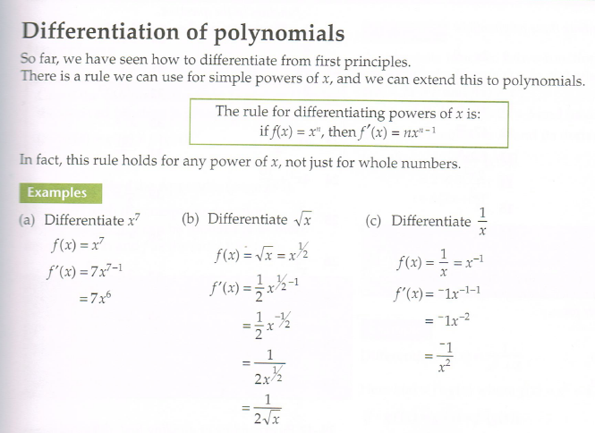
Polynomials: One NZ Textbook
The University of Auckland

Slide 61
Polynomials: Definition
The University of Auckland
A polynomial in one variable is an expression of the form:
Where x is a real variable and each a_{i} is a real number (nb you can, of course, define other polynomials using, for example, complex numbers)
Why is this useful? We can determine whether we have a polynomial or not.
Is x + 1 a polynomial?
Is 0 a polynomial?
Notes:
Can have polynomials with complex coefficients

Slide 62
Student Thinking: Composite function, f(g(x))
The University of Auckland
I'm not completely familiar with…I do have to look at them and say o.k. well, the domain becomes range for the.. if it's this way around, and vice versa, the range becomes domain if it's that way around, I don't know that off the top of my head…I know how you do it but I don't believe I could tell you why you do it…I would have to probably look up which way around it goes, um…from memory, it's backwards. So I put the f into the g I think. f of g [ie f(g)]. Um…just thinking about that. I would have to check that. I'm not a hundred percent sure of that. But then I can get g of f [ie g(f)] so I presume there’s something special about which way around it goes, I'm not entirely certain of why, or which way around.
Chinnappan, M., & Thomas, M. O. J. (2003). Teachers’ function schemas and their role in modelling. Mathematics Education Research Journal, 15(2), 151–170.

Slide 63
Student Thinking on Notation: dy/dx
The University of Auckland
I couldn't do dy/dx, and as soon as I hit university it changed, and I don't know what made me change from
f ’(x) because through school, sixth and seventh form,
f ’(x) was, I mean, that's what I worked with. I liked that. And then all of sudden it became necessary to use this form although I got completely stumped in first year calculus with it. And it took me a long time to figure it out, but once I did it was great, like a revelation.
Chinnappan, M., & Thomas, M. O. J. (2003). Teachers’ function schemas and their role in modelling. Mathematics Education Research Journal, 15(2), 151–170.

Slide 64
The Need for Care
The University of Auckland
If F(x) is defined on [a,b] and continuous on (a,b) then for any N between F(a) and F(b) there is some point c between a and b for which F(c) = N
.
F(a)
o
o
.
N
F(b)
0
a
b

Slide 65
If g(a) = 0 then the rational function
(i.e. f(x) and g(x) are polynomials) has a vertical asymptote at the point x = a
The University of Auckland
The Need for Care
2
1
1

Slide 66
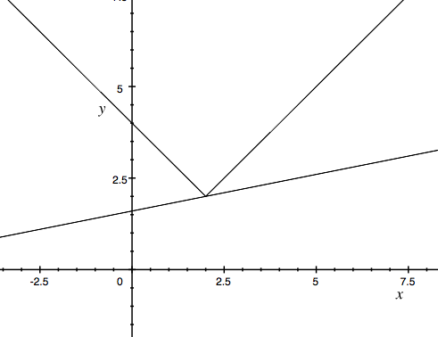
Describing Tangents
The University of Auckland
How might we describe a tangent to a graph of a function?
A line that touches a graph at a single point?

Slide 67
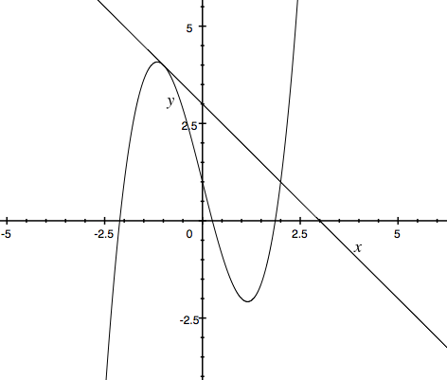
Describing Tangents
The University of Auckland
How might we describe a tangent to a graph of a function?
A line that touches a graph at a single point?

Slide 68
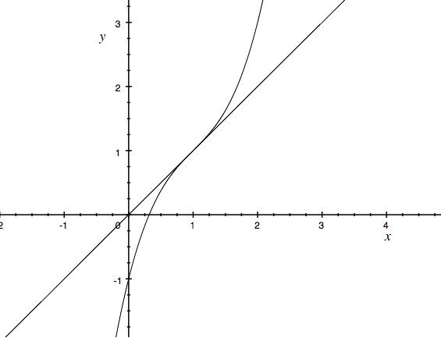
Describing Tangents
The University of Auckland
How might you describe a tangent to a graph of a function?
A line that touches but doesn’t cross the the graph?

Slide 69
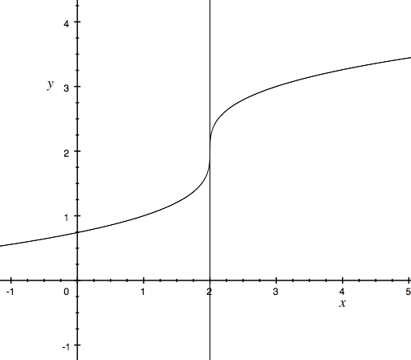
Describing Tangents
The University of Auckland
If we say “A line that passes through a point on the curve and has the same gradient as the curve at that point” then is this a tangent?
The line x = 2 for the graph of
y = (x–2)^{1/3}+2

Slide 70
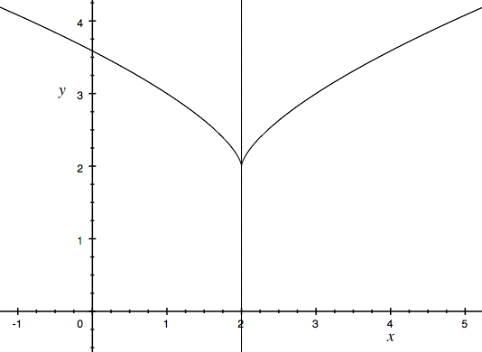
Describing Tangents
The University of Auckland
What if a student asks if this is a tangent?
The line x = 2 for the graph of
y = (x–2)^{2/3}+2

Slide 71
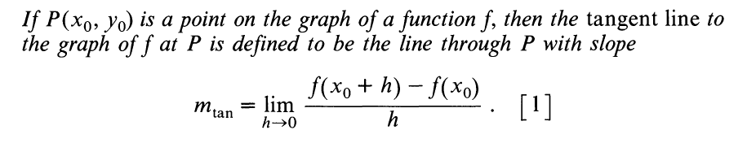
Tangents – A definition to check with
The University of Auckland
One possible definition is:
if the limit exists!
See the last two examples.
Bivens, I. C. (1986). What a tangent line is when it isn’t a limit. College Mathematics Journal, 17(2), 133-143.

Slide 72

Definitions and asymptotes
The University of Auckland
We may sometimes use the following method for find a horizontal asymptote for a rational function:
So the horizontal asymptote is y = 2.5

Slide 73

Definitions and sloping asymptotes
The University of Auckland
What would we say to a student who finds the sloping asymptote for the function
this way?
Hence the sloping asymptote is
Notes:
I saw this in a NZ classroom

Slide 74
Definitions and sloping asymptotes
The University of Auckland
What is the definition? We say that if
then the line y = ax + b is a sloping asymptote. Since, dividing,
We need

Slide 75
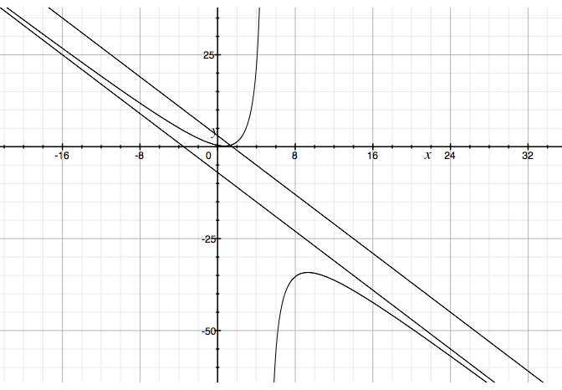
Definitions and sloping asymptotes
The University of Auckland

Slide 76
Examples of Technology Use: GeoGebra
The University of Auckland
Riemann sums
Accumulation functions
Application to ln(x)

Slide 77
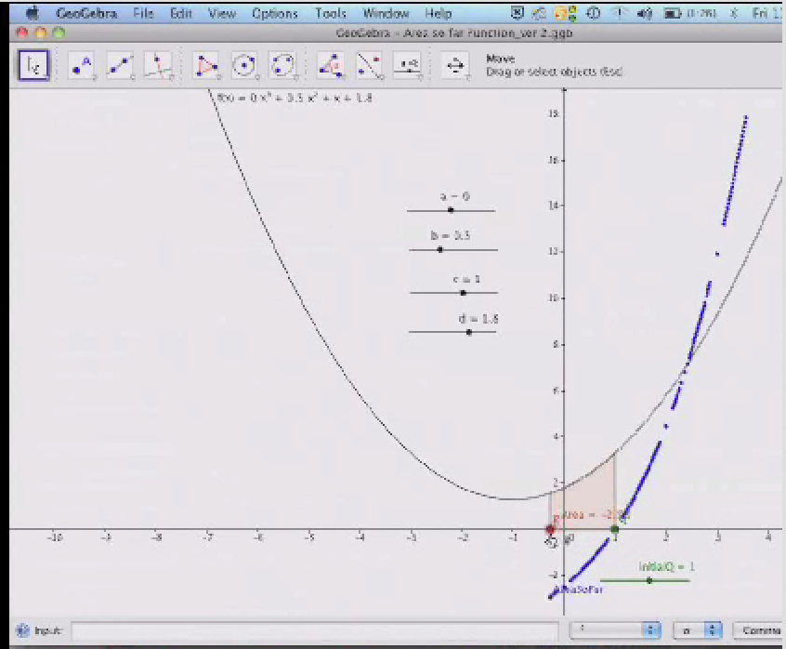
Technology use: Area so Far
The University of Auckland

Slide 78
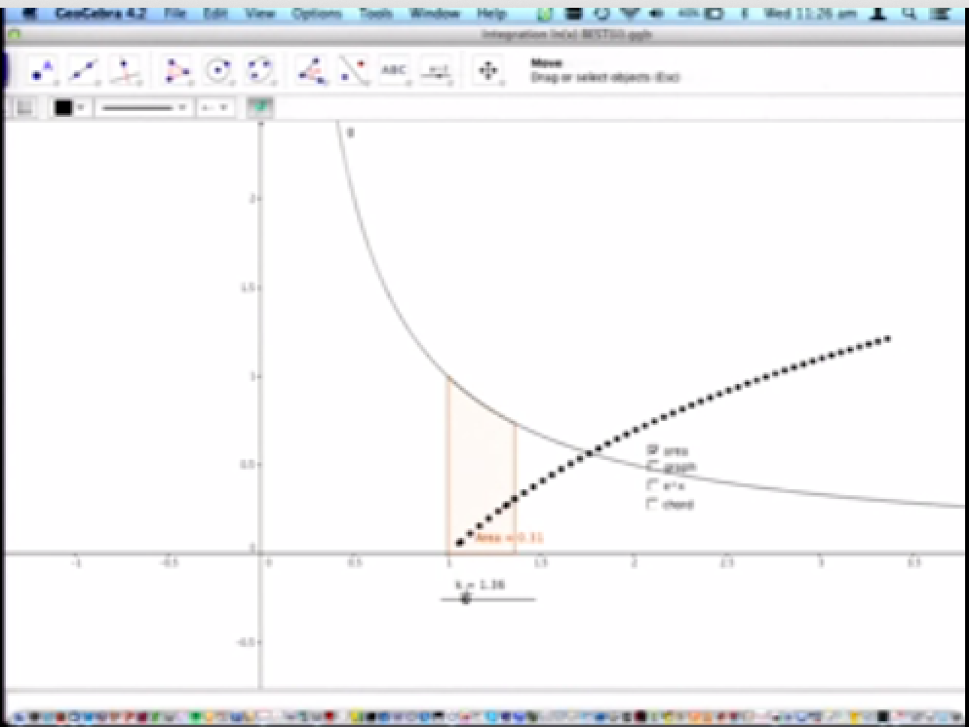
Technology use: Area so Far for lnx
The University of Auckland

Slide 79
Aiming Wider
The University of Auckland
I have suggested that this could be good for our students. It might involve:
Increasing mathematics knowledge at the horizon
Paying attention to student thinking about mathematical constructs
Aiming for versatile thinking in our students
Considering the precision of what we say in teaching
Thinking carefully about definitions
Employing technology to open up areas for investigation

Slide 80
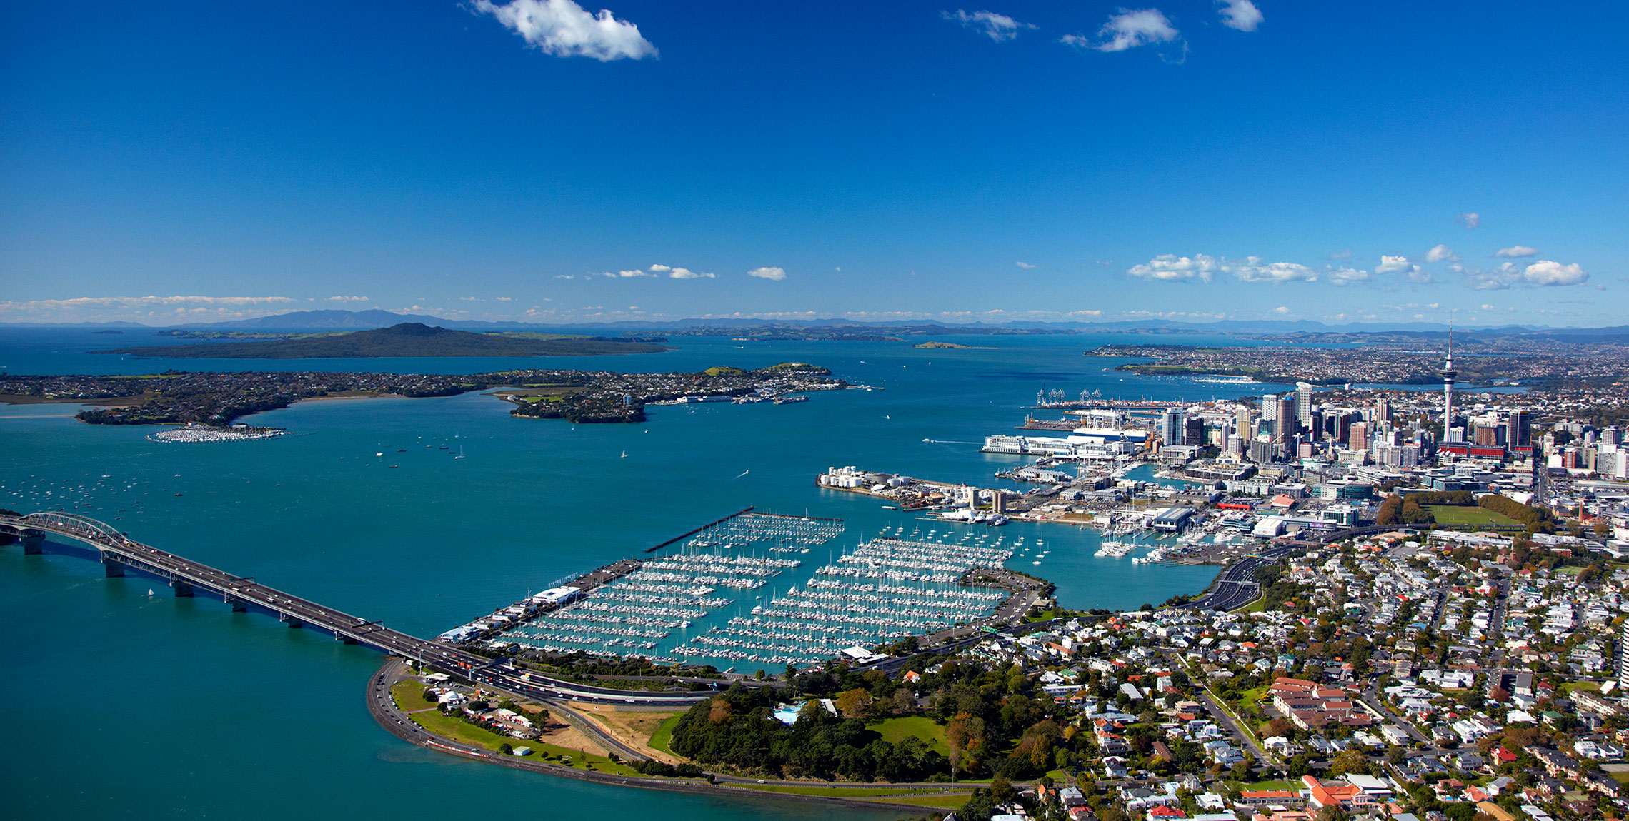
Contact: moj.thomas@auckland.ac.nz
The University of Auckland
Notes:
One of 48 volcanoes

